Slide 1
An Evaluation of
Prioritized
Dynamic Continuous Indexing
One-Semester Project
The University Of Melbourne
Supervised by
Trevor Cohn
Matthias Petri
by
Shuai Wang
Thu 17 May, 2018
Notes:
Good afternoon, everyone?
My name is Shuai Wang.
Today I will introduce you a new method to do k-nearest neighbor search, which is prioritized dynamic continuous indexing.

Slide 2
K-Nearest Neighbor Search (KNN)
K=3
K=5
K=9
KNN
1/6
Notes:
What is k-nearest neighbor search?
Simply say, it is to find k points in a given set that are closest to a given point.
For example, we have a dataset here.
What are the top 3 nearest neighbors of the red point?
A simple way to do that is to compute the distance from the red point to every other points. Those three points with shortest distances are viewed as the top 3 nearest neighbors. So, these three points in the circle are the top 3 nearest neighbors of the red point.
In the same way, we can also find the top 5 and top 9 nearest neighbors of the red point.
Okay, this is the basic idea of k-nearest neighbors search.

Slide 3
KNN - Algorithms
Classical
k-d tree (Bentley, 1975)
R-tree (Guttman, 1984)
X-tree (Berchtold etc, 1996)
LSH (Indyk & Motwani, 1998)
Spill tree (Liu etc, 2004)
RP tree (Dasgupta & Freund, 2008)
Virtual spill tree (Dasgupta & Sinha, 2015)
Approximate
Dynamic Continuous Indexing(DCI) (Li & Malik, 2016)
Prioritized DCI (Li & Malik, 2017)
KNN - Algorithms
2/6
Notes:
Over the past several decades, a collection of algorithms of k-nearest neighbor search have been proposed.
The majority of them are based on space partitioning. However, these algorithms suffer from the curse of dimensionality, which refers that a linear increase in dimensionality leads to exponential increase in query time and space.
A new method proposed by Li and Malik in 2016, called dynamic continuous indexing DCI, can avoid partitioning the space and escape from the curse of dimensionality. They later published an improved version call Prioritized DCI.
My project focuses on the two algorithms.

Slide 4
Dynamic Continuous Indexing(DCI)
1
8
14
7
5
12
3
9
2
4
13
11
15
6
10
CITATION: Li, K., & Malik, J. (2016, June). Fast k-nearest neighbour search via dynamic continuous indexing. In International Conference on Machine Learning (pp. 671-679).
DCI
3/6
Notes:
Let's talk about DCI first.
We have a dataset here. We want to find the k-nearest neighbors of the red point.
First of all, we choose a random direction.
Then, project all points along the direction.
The main intuition of DCI is the relative order between those projections approximately represents the relative order between those points.
In this case, the projections of point 7 and point 8 are closer to the projection of red point than other projections. So we could say the two points are likely to be closer to red point than other points. In other words, the two points are approximately the top 2 nearest neighbors of the red point.
But only-one-direction-projection is not enough. Because a point is closer along this direction but it might be far away along another direction. So we need multiple random directions to get the average k-nearest neighbors.

Slide 5
Dynamic Continuous Indexing(DCI)
1
8
14
7
5
12
3
9
2
4
13
11
15
6
10
CITATION: Li, K., & Malik, J. (2016, June). Fast k-nearest neighbour search via dynamic continuous indexing. In International Conference on Machine Learning (pp. 671-679).
DCI
3/6
Notes:
Here, along this direction, point 1, 7, 8 and 14 are closer to the red point than other points along the direction.

Slide 6
Dynamic Continuous Indexing(DCI)
1
8
14
7
5
12
3
9
2
4
13
11
15
6
10
CITATION: Li, K., & Malik, J. (2016, June). Fast k-nearest neighbour search via dynamic continuous indexing. In International Conference on Machine Learning (pp. 671-679).
DCI
3/6
Notes:
Along this direction, point 7, 8, 12 and 13 are closer to red point.

Slide 7
Dynamic Continuous Indexing(DCI)
1
8
14
7
5
12
3
9
2
4
13
11
15
6
10
CITATION: Li, K., & Malik, J. (2016, June). Fast k-nearest neighbour search via dynamic continuous indexing. In International Conference on Machine Learning (pp. 671-679).
DCI
3/6
Notes:
Overall, the projections of point 7 and point 8 are the closest to the projection of the red point along the three directions. So we have more confidence to say that the two points are more probable to be the top 2 nearest neighbors of the red point. If the number of directions approaches infinity, the two points will be the true top 2 nearest neighbors.
In DCI, points are randomly visited one by one along multiple directions, then check if it is closer to a given point along all directions, if it is, retrieve it as a neighbor, until we find k-neighbors.

Slide 8
Prioritized DCI
-4
-1
-0.5
-4.2
1
8
14
7
-1.5
-2.2
-3
5
12
3
9
4
-1
2
-2.5
11
13
-3.2
-2
-3
15
-3.5
6
-2
10
-1.5
CITATION: Li, K., & Malik, J. (2017). Fast k-Nearest Neighbour Search via Prioritized DCI. arXiv preprint arXiv:1703.00440.
Prioritized DCI
4/6
Notes:
But in prioritized DCI, points are visited by priority.
The priority of each point is set to the negative absolute difference between the query projection and point projection.
For example, point 7 has a priority of -1 while point 1 has a priority of -4.
The intuition of prioritized DCI is that the point with higher priority is more likely to be closer to query point. In other words, it’s more probable to be a nearest neighbor.
Generally, we first visit point with higher priority, check if the point is closer to query point along all random directions, if it is, retrieve it as a neighbor. Then visit point with lower priority. Until find k neighbors.
Based on the idea of DCI and Prioritized DCI, I implemented the two algorithms in python and did some evaluation.

Slide 9
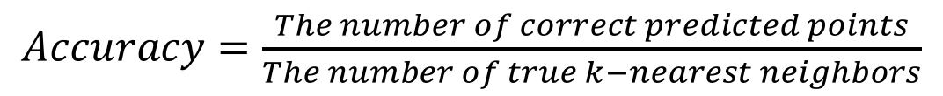
Preliminary Results
Dataset | DCI | PDCI 0.15k0 0.55k1 | PDCI 0.55k0 0.8k1 | PDCI k0 k1 | BF | K-D Tree | Ball Tree
1K | 10% 7 mins | 20% 16 s | 30% 22 s | 40% 26 s | 100% 3 ms | 100% 0.9 ms | 100% 0.5 ms
10K | 0% 4 h 24 mins | 10% 19 mins | 10% 27 mins | 10% 32 mins | 100% 17 ms | 100% 7 ms | 100% 2 ms
MNIST (70K) | ?% days | 20% 14 hours 44 mins | 40% 22 hours 23 mins | 50% 27 hours 33 mins | 100% 321 ms | 100% 99 ms | 100% 97 ms
$Accuracy=\frac{The number of correct predicted points}{The number of true k−nearest neighbors}$
Preliminary Results
5/6
Notes:
Here are the preliminary results. I have to say that my implementation needs to be refined next a couple of weeks. It’s not efficient now. So the results might not have enough persuasiveness. But we can still get some general information.
Points in the first two datasets are uniformly distributed. I also used MNIST dataset.
I evaluated DCI, Prioritized DCI, Brute Force, k-d tree and ball tree on those datasets. For PDCI, I used three different parameters setting.
In each cell, the first value is accuracy representing how much true neighbors are found. The second value is query time.
We can observe that Prioritized DCI performs much better than DCI. It got higher accuracy and shorter query time.
But compared with brute force, k-d tree and ball tree, DCI and Prioritized DCI perform much worse. But again, i have to say it's bot true in theory.

Slide 10
Conclusion
Projection along multiple directions
Priority
6/6
Conclusion
Notes:
To conclude,
First, instead of partitioning the space, DCI projects points along multiple random directions, retrieve those points whose projections are closer to query along projections all directions as approximate k-nearest neighbors.
Second, Prioritized DCI visits points by priority. Those points with high priorities are more likely to be closer to query, and are more likely to be a true neighbor. It shows a remarkable improvement on DCI.
Third, DCI and Prioritized DCI should perform better than brute force or other algorithms in theory. But unfortunately my implementation did not prove that yet. I’ll continue to refine my code. Hope get persuasive results.
Okay, thank you!

Slide 11
Question
Notes:
any question?

Slide 12
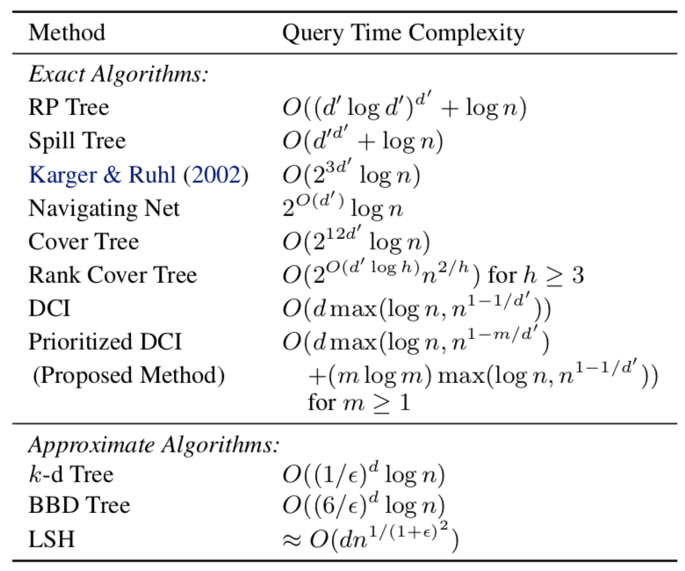
Appendix - Complexity
CITATION: Li, K., & Malik, J. (2017). Fast k-Nearest Neighbour Search via Prioritized DCI. arXiv preprint arXiv:1703.00440.
Notes:
To conclude,
First, instead of partitioning the space, DCI projects points along multiple random directions, retrieve those points whose projections are closer to query along projections all directions. They are viewed as approximate k-nearest neighbors.
Second, Prioritized DCI visits points by priority. Those points with high priorities are more likely to be closer to query, and are more likely to be a true neighbor. It shows a remarkable improvement on DCI.
Third, DCI and Prioritized DCI should perform better than brute force or other algorithms in theory, but they actually performed worse in my implementation. They get low accuracy and longer query time.
Okay, thank you!

Slide 13
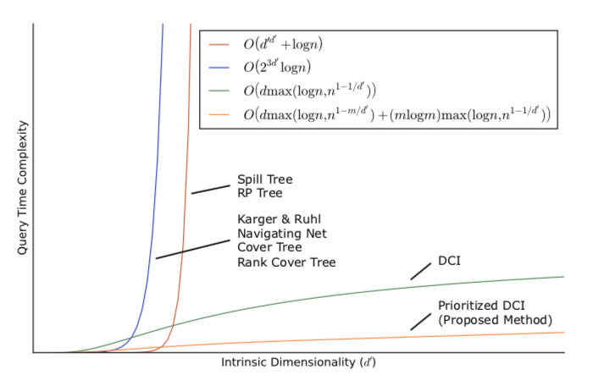
Appendix - The curse of dimensionality
CITATION: Li, K., & Malik, J. (2017). Fast k-Nearest Neighbour Search via Prioritized DCI. arXiv preprint arXiv:1703.00440.

Slide 14
Appendix - The curse of dimensionality
Query Time
Dimensionality
CITATION: Li, K., & Malik, J. (2017). Fast k-Nearest Neighbour Search via Prioritized DCI. arXiv preprint arXiv:1703.00440.

Slide 15

Candidate Set
Composite Indices
Simple Indices
Random Unit Vectors
AVL Trees
Node
…
L
…
m
…
n
⟨${\overline{p}}_{jl}^{i}$,$h_{jl}^{i}$⟩

